Slide 1
“If I Had a Gun I’d Shoot Him”
Being a Catholic Physician in an Era of “Choice”
Deacon Dr. Randy Abele
April 5, 2014

Slide 2
Physicians and End-of-Life Care
Euthanasia
Physician-assisted Suicide
Advance Care Directives

Slide 3
Physician’s Role
“The physician's role is to make a diagnosis, and sound judgments about medical treatment, not whether the patient's life is worth living.”

Slide 4
Medical Ethics
“Primum non nocere”
Hippocratic oath

Slide 5
Factors Affecting Physicians
Pluralistic culture: colleagues and patients
Rise of secularism – the “Godless society”
Science – “We are not different than animals”
Individualism & desire for control or “choice”
Consumer demand and “need to please”

Slide 6
Euthanasia
Action or omission that brings about the death of a person – the intent of the act is death

Slide 7
Euthanasia is not:
Withholding, withdrawing, or refusal of medical treatment
Palliative care

Slide 8
Euthanasia
Confusion reigns about rights that we already have: the right to refuse or withdraw treatment.

Slide 9
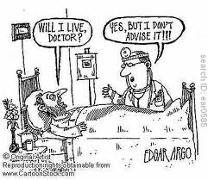
Alberta Health Services?

Slide 10
Multiculturalism and Views of Euthanasia
Buddhism: mixed views - generally opposed
Christian: Protestant conservative – opposed
Christian: Protestant liberal – variable
Christian Catholic – strongly opposed
Hindu – effect on karma bad, good deed
Islam – opposed
Judaism – mostly opposed
Sikhism – mostly opposed

Slide 11
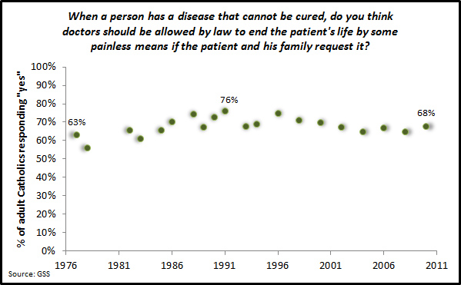
Catholic Attitudes
Center for Applied Research in the Apostolate (CARA) at Georgetown University

Slide 12
Quebec Bill 52
The guiding principle of this bill was radical personal autonomy. The patient decides if their life is worth living. Or not.
it’s part of the “progressive evolution of social values” THAT YOU GET TO HAVE A DOCTOR KILL YOU IF YOU SO WISH.

Slide 13
PQ in Quebec – Bill 52
The majority of people who are promoting Bill 52 are not doctors.
Most of physicians promoting the bill are not in clinical practice
Bill died with election call – future?

Slide 14
Terminology
The term “medical aid in dying” is intended to make euthanasia into a “health issue” and therefore a provincial matter, circumventing the prohibition of euthanasia and physician assisted suicide in the Canadian Criminal Code, which is a federal matter.

Slide 15

Physician’s Alliance for the Total Refusal of Euthanasia

Slide 16
Physician’s Alliance for the Total Refusal of Euthanasia
Pro: access to care to alleviate suffering
: respect for the wishes of the patient
: universal access to palliative care
: physician access to pain specialists
: sedation to optimize patient comfort
: to provoke death is not “medical care”
: learn the harm caused in other countries
: medical licensing bodies to support care

Slide 17
Catholic Perspective
Allow the illness to take its course when:
no reasonable hope of benefit from treatment
when treatment incurs excessive burden
when death is imminent
when medical treatment just prolongs dying

Slide 18
Fluids and Nutrition at End-of Life
in 2004, Pope Blessed John Paul II stated that artificial feeding and hydration were not classified as extraordinary. (like bathing the patient or changing the patient’s position to prevent bedsores).
“Death by starvation or dehydration is, in fact, the only possible outcome as a result of their withdrawal. In this sense it ends up becoming, if done knowingly and willingly, true and proper euthanasia by omission.”
Withdrawal of fluid and nutrition can be done if would only cause more suffering.

Slide 19
The Terminally Ill Patient
Often have a loss of self-esteem
May be embarrassed about changed appearance
May feel a burden to others
May feel depressed
May feel worthless
DO WE SAY BY OUR ACTIONS: “YOU’RE RIGHT”?

Slide 20
Physician Concerns
There is no scientifically acceptable definition of unbearable physical or psychological pain – wrongful death can occur
Patients can change their minds - or undue influence of family
Doctor’s diagnoses and prognoses can be wrong
Legal euthanasia will erode the trust in a patient-doctor relationship

Slide 21
Physician Concerns
There will be adverse effects on psyche of the doctor
Euthanasia is but an illusion of control, dignity, and choice – dignity cannot be reduced to personal convenience
Psychiatrists can be exploited by the state
No way to exercise conscientious objection

Slide 22
A Psychologist Reports
French psychologist – confidante to doctors and nurses who have euthanized:
This radical act is a violent act
Prolonged nightmares
Haunted by the last look from the patient
Unending depressions

Slide 23
Euthanasia
Jean-Marc Lapiana, Director of la Maison de Soins Palliatifs in Gardanne (France):
"If we are opposed to the legalization of euthanasia, it is not for moral or religious reasons, but because if we had the legal possibility to kill our patients, I and the team with whom I work would not give ourselves all the trouble that we do to find solutions for difficult situations.”

Slide 24
Euthanasia
Killing a patient is much easier than treating and accompanying someone until her death comes naturally and peacefully.

Slide 25
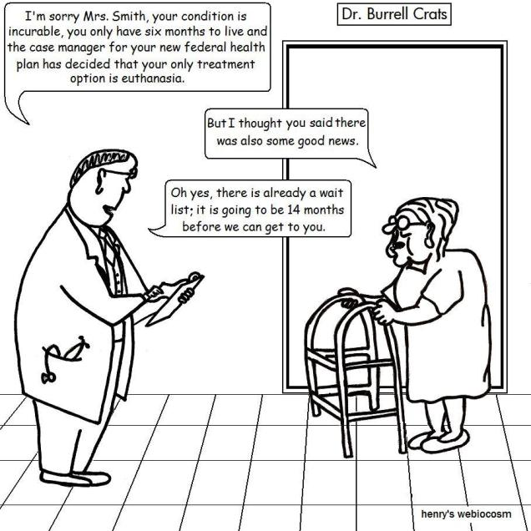
Alberta Health Services?

Slide 26
Three Basic Principles in Canadian Law
The protection of human life is a fundamental value.
The patient has the right to autonomy and self-determination in making decisions about his or her medical care.
Human life needs to be considered from a quantitative and qualitative perspective.

Slide 27
Canadian Medical Association
“current stance on palliative care is: euthanasia and assisted suicide should be rejected in favor of palliative care. The Association believes Canada needs to devote more funding to palliative care as a viable end-of-life care. “
Supports the right of physicians to exercise conscientious objection

Slide 28
Palliative Care
Focuses on meeting physical, emotional, and spiritual needs of people at the end of their lives.
Effective pain management
Sedation can be used if necessary

Slide 29
Palliative Care in Canada and Quebec
Only 16% to 30% of Canadians (10% – 20% in Quebec) who die currently have access to or receive hospice palliative and end-of-life care services

Slide 30
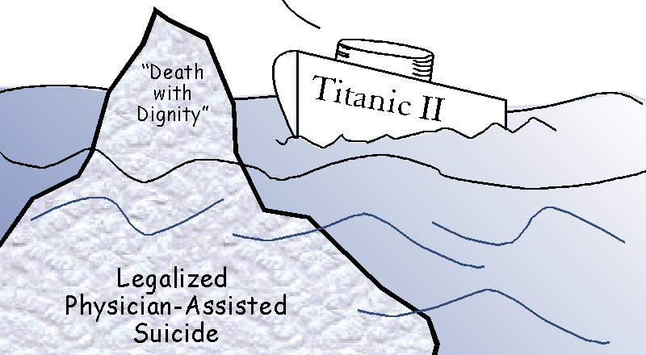
Physician-Assisted Suicide

Slide 31
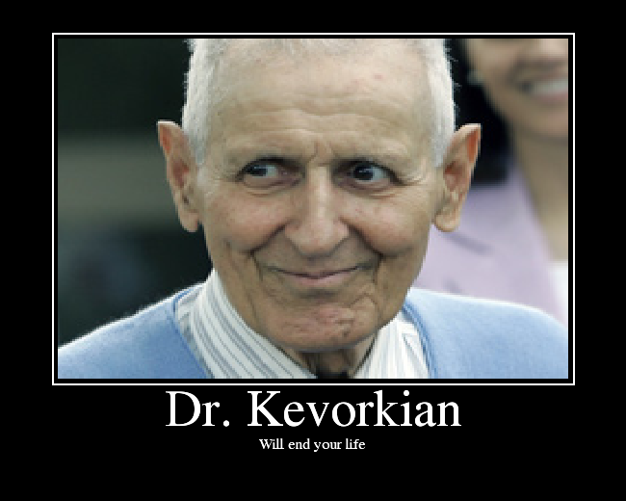
Physician Assisted Suicide

Slide 32
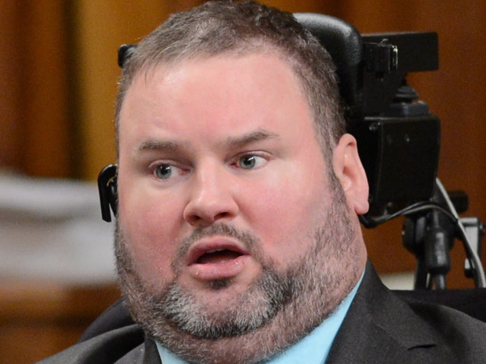
Doctor-Assisted Suicide
Two New Bills Introduced – Steven Fletcher MP

Slide 33
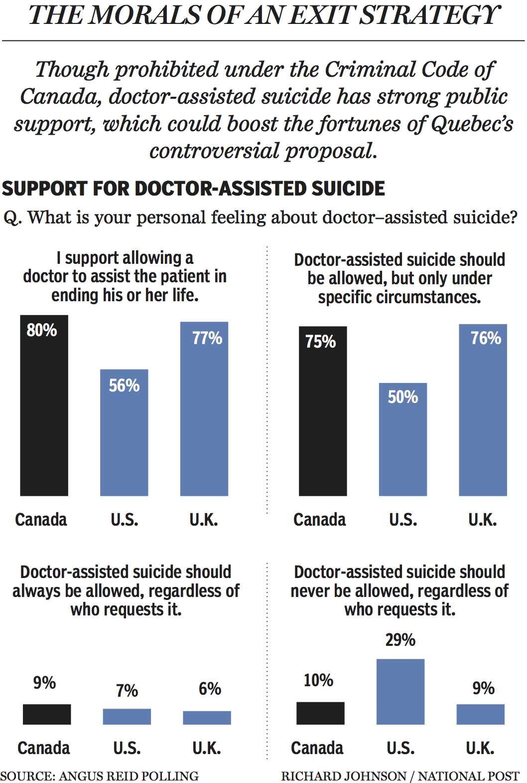
Popular Support for Doctor Assisted Suicide

Slide 34
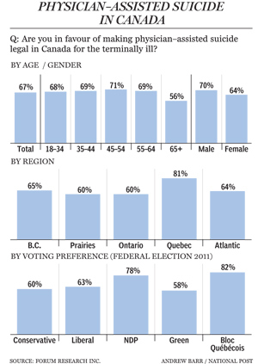
Physician-Assisted Suicide

Slide 35
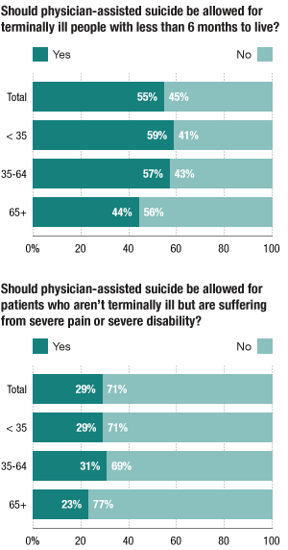
Physician-assisted Suicide
US

Slide 36
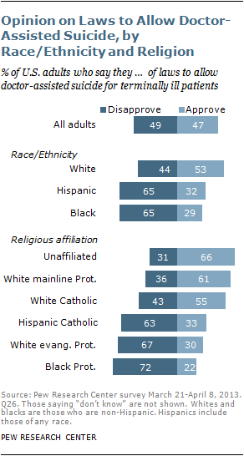
Doctor Assisted Suicide
US

Slide 37
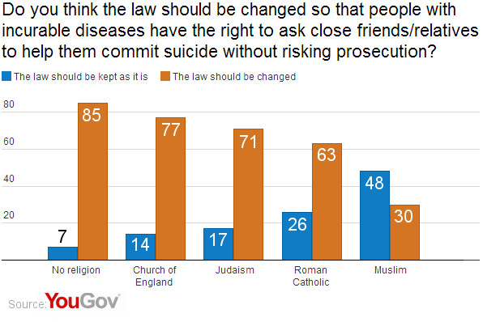
Assisted Suicide
UK

Slide 38
Physician-assisted suicide: physician support
March 2013 CMAJ: only 16% would take part
September 2013 NEJM: Survey. 36% MD’s in 74 countries were in favour of physician assisted suicide.

Slide 39
Advance Directives
Should be respected when available and applicable
Not followed in all cases: e.g. too specific or too general

Slide 40
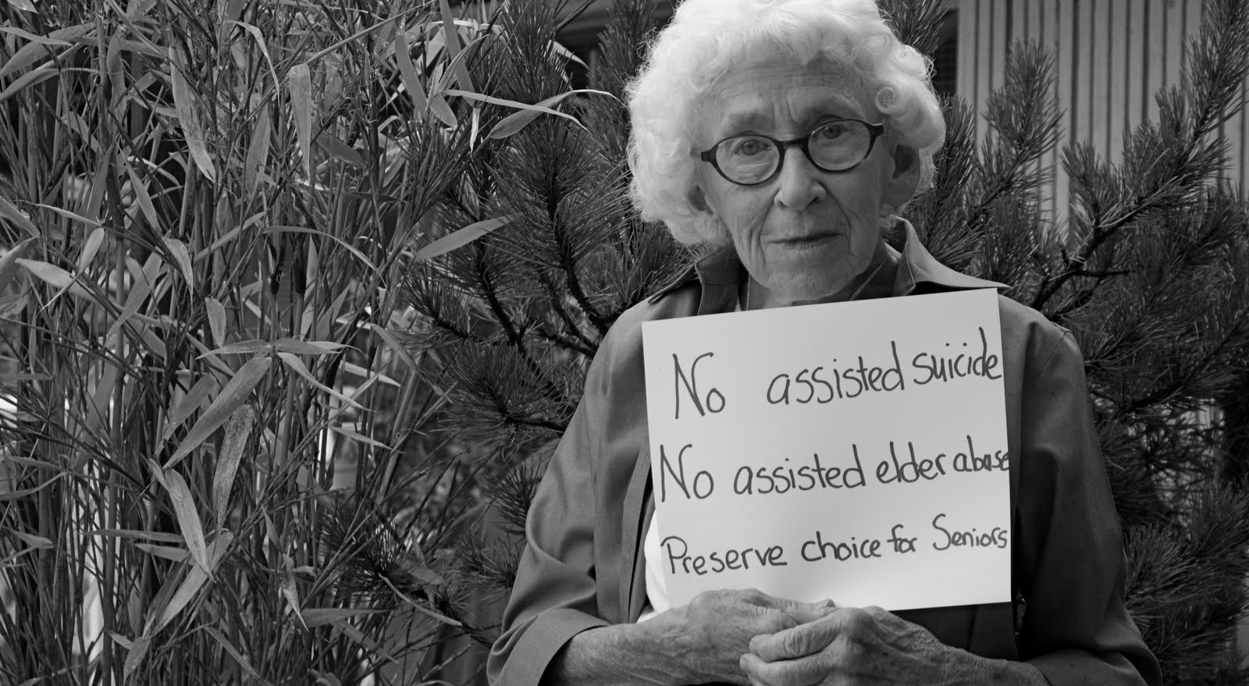
Advance Directives

Slide 41
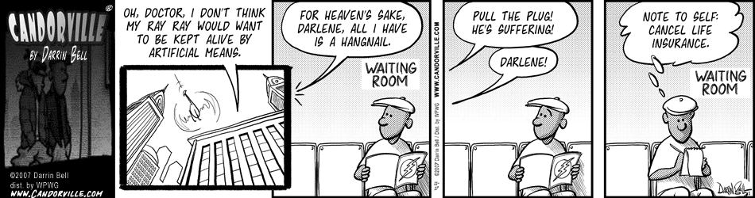
Advance Directives

Slide 42
Catholic Perspective
Faith in Jesus Christ – offers Divine life
Jesus taught us to love others especially the suffering
We are not to kill. ” Choose life”
We are to provide comfort ,care, and hope
One never loses their human dignity
God has the “big picture” – He is sovereign

Slide 43
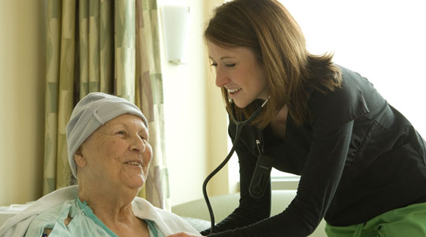
Pray for Health Care Professionals

